Slide 1
What is statistics?

Slide 2
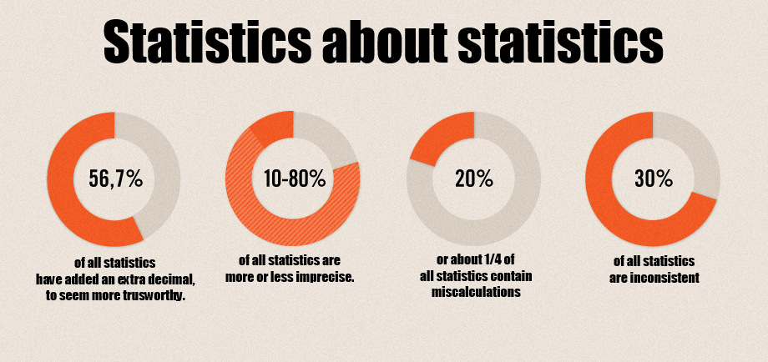
Notes:
What is a statistician / detective.

Slide 3
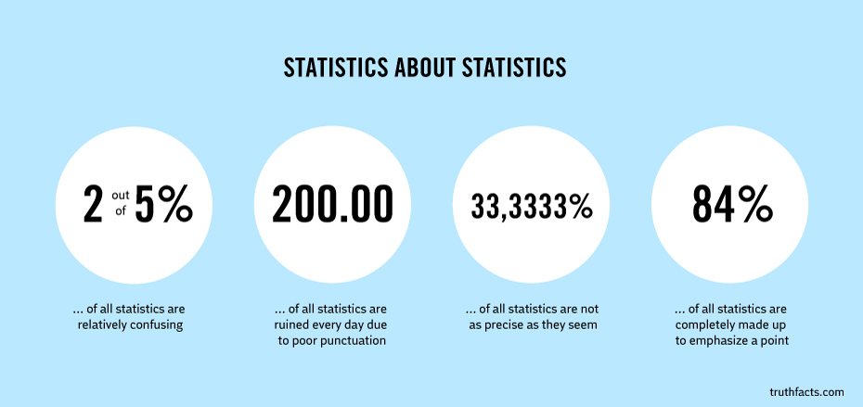

Slide 4
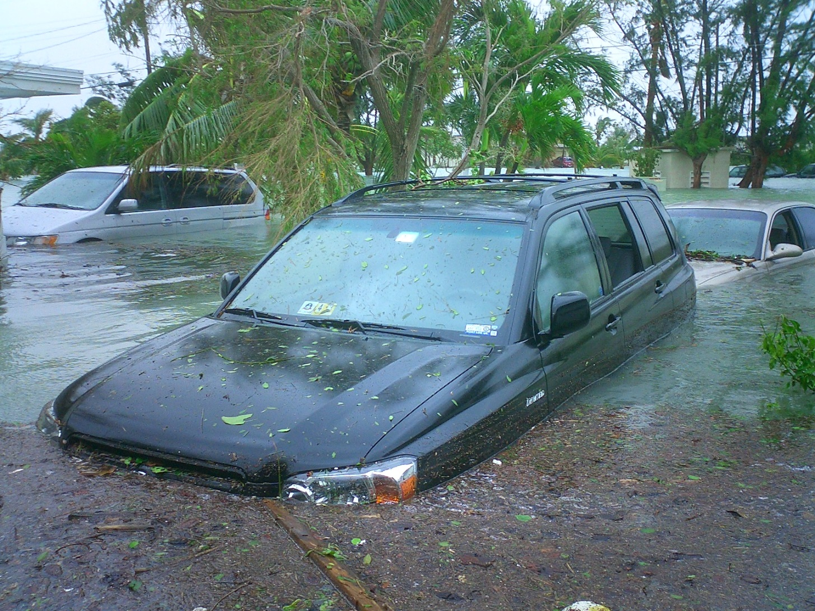

Slide 5

Notes:
Who going to win the World Cup? Best team doesn’t always win. Chance? Previous results - how far back? Home/away? International games? Friendly.

Slide 6

Notes:
You run BT. Repair jobs. How many engineers on which day? Which jobs to do first? Don’t know arrival rate for jobs. Types of jobs / time? Peak? Engineers might be sick, or might not be skilled for the type of jobs that come in?
What links them all? Uncertainty

Slide 7

https://www.youtube.com/watch?v=8vNJ5Krj7SQ
Notes:
Humans suck at uncertainty.
We see patterns where there aren’t any.

Slide 8
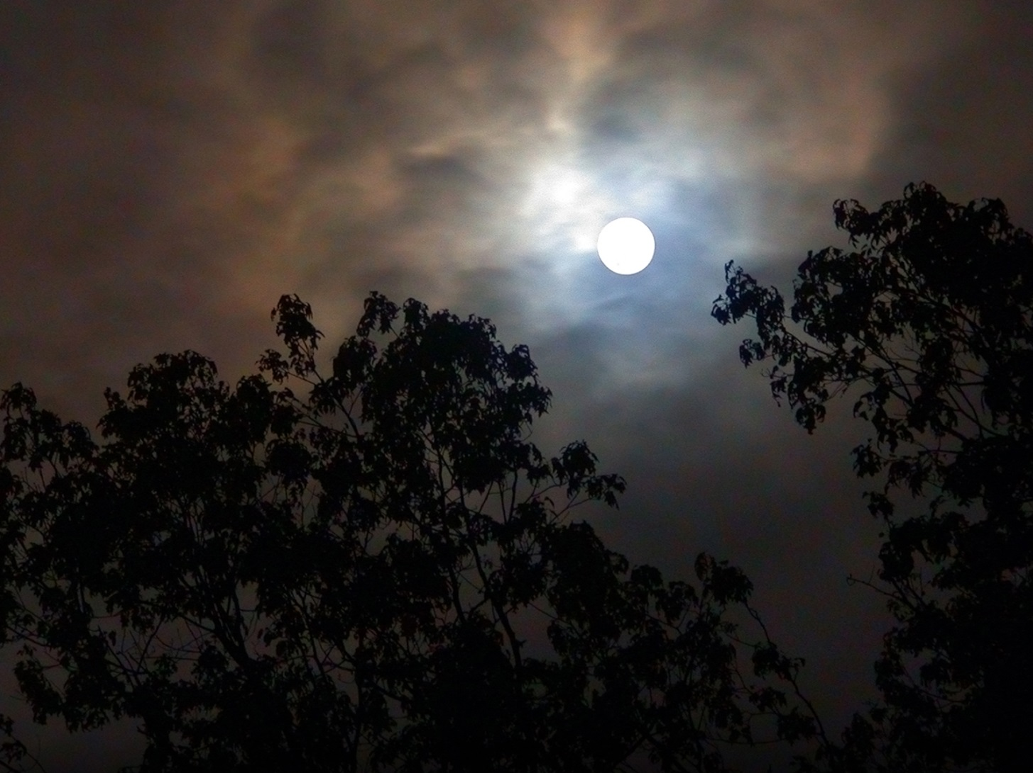
Notes:
Where randomness is concerned. Our instincts are often wrong. Statistics bring formal thinking .

Slide 9
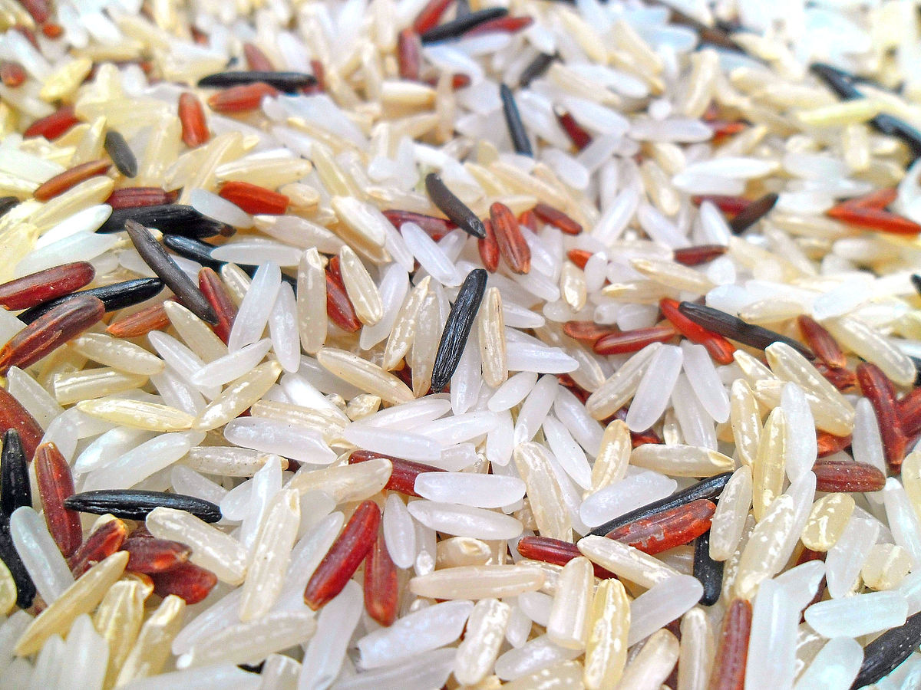
Notes:
Patches. The rice has clustered. All even spread would be unusual. This is a model. Why is it not accurate?

Slide 10
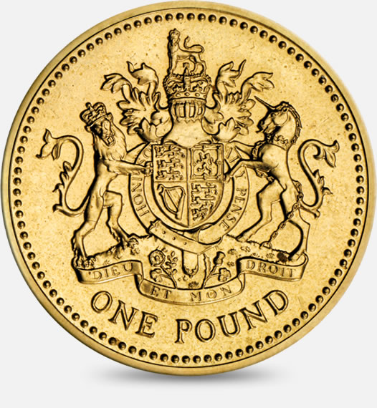
Notes:
Even in short runs, there can be big clusters

Slide 11
Recap
Statistics helps us understand uncertainty.
Statisticians are everyday detectives.
Randomness doesn’t always look random.
Even in short runs there can be big clusters.
Chance doesn’t mean without cause.
Tree or a tiger?

Slide 12
Problem Session 1
http://understandinguncertainty.org/coincidences
http://www.dailymail.co.uk/sciencetech/article-1240746/Prehistoric-sat-nav-set-ancestors-Britain.html

Slide 13
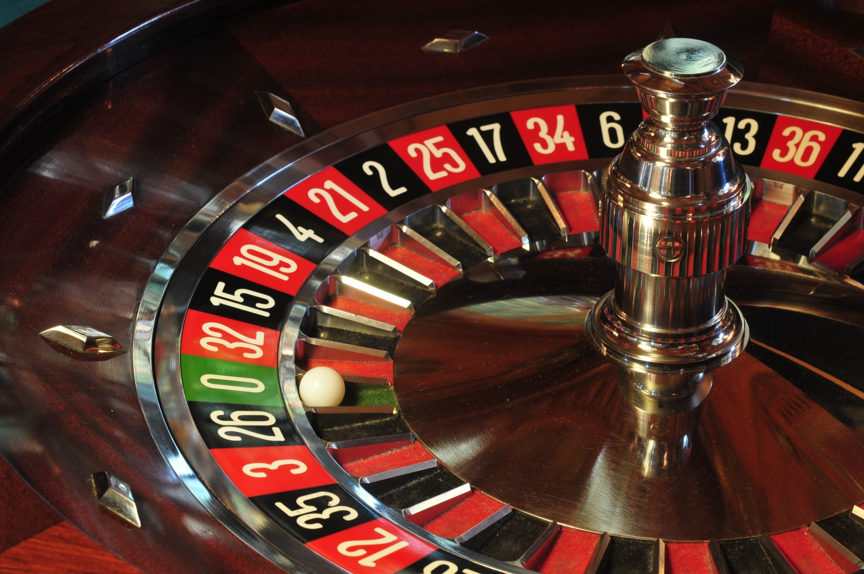
Games and Gambling
Notes:
Games and gambling, Why mathematician find it interesting. Has anyone gambled? Computer GAMES

Slide 14
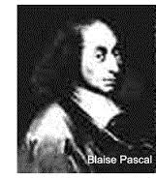
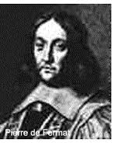
Gambler’s Ruin
Notes:
Introduce Gambler’s Ruin. Play with kidz.

Slide 15
The Simple Game
Player starts with £10
Player tosses a coin
Heads wins £1
Tails loses £1
Play until you win £20 (WIN)
Or run out of money (LOSE)

Slide 16
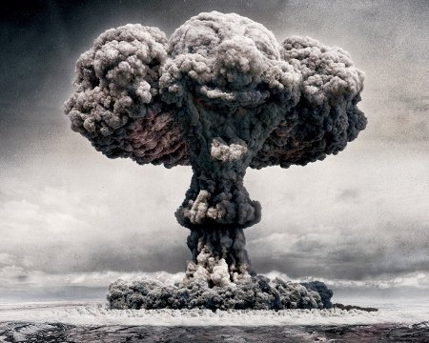
Monte Carlo Simulation
Notes:
Stanislaw Ulam and Von Neumann.

Slide 17

Why simulate?
Notes:
Global Warming

Slide 18
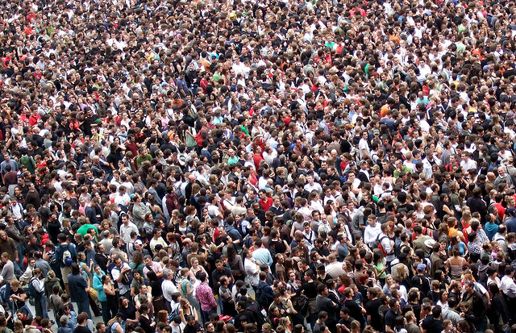
Populations and Samples

Slide 19
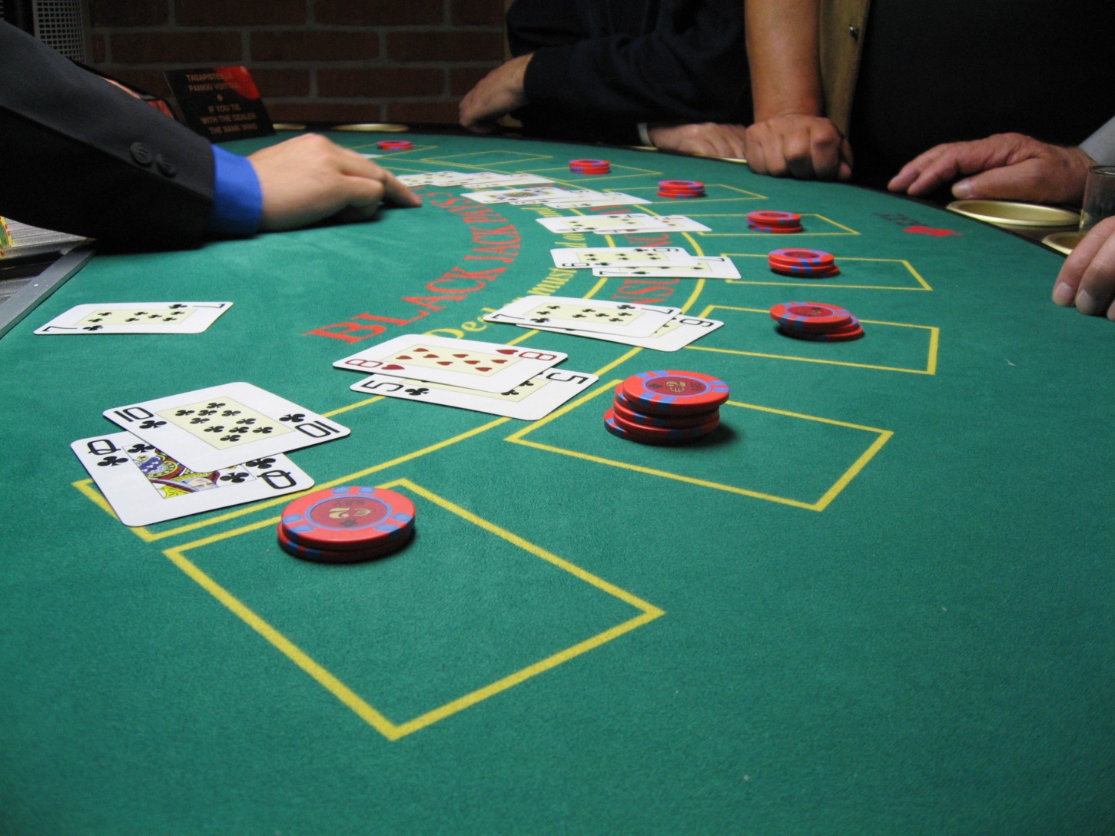
Blackjack and Bankrolls

Slide 20
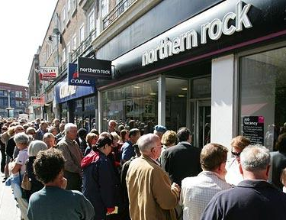

Real World

Slide 21
Recap

Slide 22
Problem Session 2
Prosecutors Fallacy
http://www.theguardian.com/uk/2003/jan/30/ukcrime.taniabranigan
Teen Pregnancies
http://news.bbc.co.uk/1/hi/scotland/highlands_and_islands/8073335.stm
Sports Illustrated
6. The Sports Illustrated Cover Curse
Origin: Eddie Mathews, the first athlete on the cover of Sports Illustrated, breaks his hand Teams/people involved: Various athletes depicted on the cover of Sports Illustrated Year started: 1954
Even from the very first cover, Sports Illustrated has been known for having some strange incidents occur in relation to their cover athletes. For the first issue, it was former Braves star Eddie Mathews, who would end up suffering a broken hand shortly after he was placed on the cover. After that, Jill Kinmont's paralysis in 1955—which occurred during the same week that she was on the cover of SI—added to the list of tragic and untimely accidents.
Since these two initial incidents, a storied history of trouble or bad luck has emerged in connection with Sports Illustrated, giving way to the belief that a jinx is associated with the magazine. Though no specific origin has been named as the reason for the curse, the common consequences that these athletes have suffered suggests a common cause to some.

Slide 23
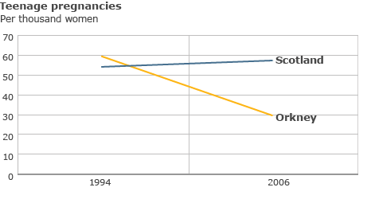

Slide 24
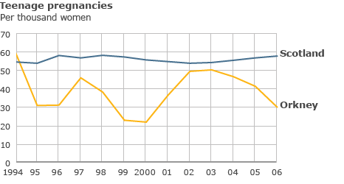

Slide 25
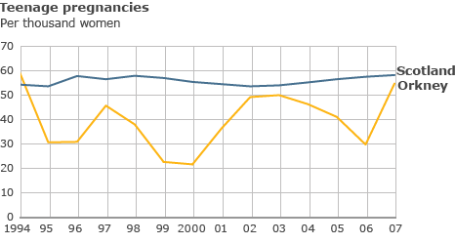

Slide 26
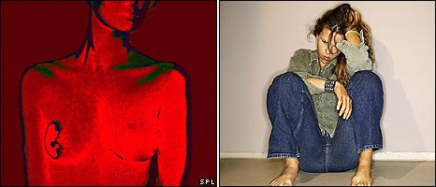
Are there dangers in breast cancer screening?
Notes:
Women going for routine breast cancer screening are being misled about the risks of being misdiagnosed, a recent report suggested. But it's vital to get the numbers in context Go for a scan and you might end up with surgery you don't need

Slide 27

Tests can be wrong
Say that routine screening is 90% accurate. Say you have a positive test. What's the chance that your positive test is accurate and you really have cancer?
Notes:
The surprise is that it's impossible to answer that question correctly with the information given. But many doctors think otherwise. They think a positive test that's 90% accurate means it's 90% likely to mean cancer. Not so.

Slide 28
10 out of 1000 women at age forty who participate in routine screening have breast cancer. 9 of every 10 women with breast cancer will get a positive mammography. 99 out of 9,90 women without breast cancer will also get a positive mammography. If 1,000 women in this age group undergo a routine screening, about what fraction of women with positive mammographies will actually have breast cancer?

Slide 29

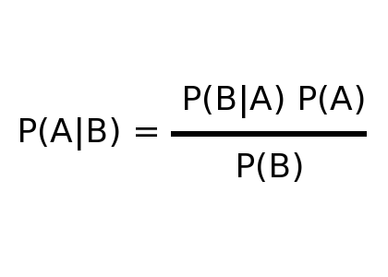
Bayes’ Theorem

Slide 30
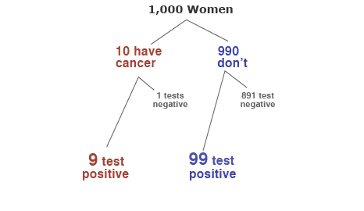
Notes:
Most of the positives from routine screening are false alarms, occurring among women who don't have cancer. Of all the women who have positive tests, only about one in ten will truly have cancer, but they won't yet know which.That's how a test with 90% accuracy can result in only about 10% certainty, and why thinking about it in percentages can leave some people muddled. Our advice is - don't. Think in people instead.

Slide 31
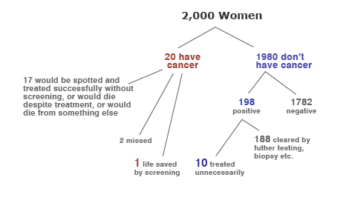
Notes:
Should the NHS strive to explain that, or to offer the reassurance most people crave? And what if doctors offer advice having misunderstood the degree of uncertainty?
The decisions are painful enough, all the more reason to be as clear as we can about the balance of risks and benefits.

Slide 32
http://understandinguncertainty.org/files/animations/BayesTheorem1/BayesTheorem.html

